Slide 1
Cloud Development Kit (CDK) Appsync & Amplify

Slide 2
Learn

Slide 3
CDK 101: What
Open-Source Framework: framework that lets you define and manage your AWS cloud infrastructure using the power of programming languages.
Infrastructure as Code (IaC):
Familiar Languages: The CDK supports TypeScript, JavaScript, Python, Java, and C#.

Slide 4
CDK 101: Why
Developer-Friendly:
Abstraction: Makes it easier to manage complex infrastructure patterns with reusable components (constructs).
AWS Integration
Testing: use your standard programming language testing tools to write tests for your infrastructure code.
Logic and Control: Programming languages allow for more complex logic, flow control, and custom abstractions within your infrastructure definitions.

Slide 5
CDK: Concept
Constructs: These are the basic building blocks of CDK applications. They represent AWS resources
L1 Constructs: Closely mirror actual AWS CloudFormation resources.
L2 Constructs: Encapsulate best practices and common patterns, making things simpler.
L3 Constructs: Provide higher-level abstractions for complex patterns or entire application components.

Slide 6
CDK: Concept
Apps: A CDK app is the container for your infrastructure code. It holds multiple stacks.
Stacks: A stack is a deployable unit of infrastructure. It groups together constructs into a single logical unit representing a portion of your application.

Slide 7
Hand-on

Slide 8
(0) Prerequisites
AWS CLI
AWS configure
Test:
aws sts get-caller-identity

Slide 9
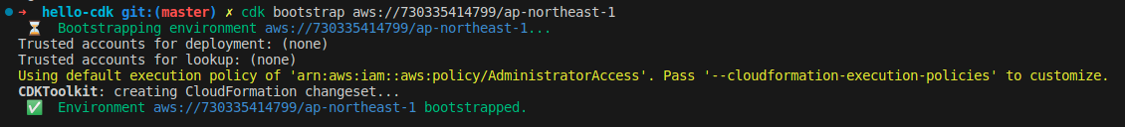
(1)Bootstrap

Slide 10
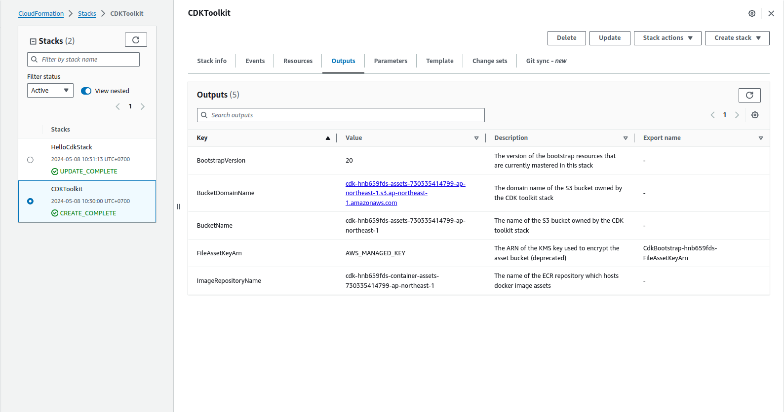
(1) Bootstrap

Slide 11
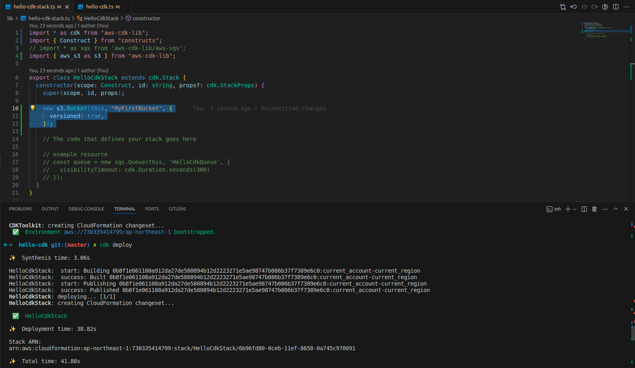
(2) Add S3 and deploy

Slide 12
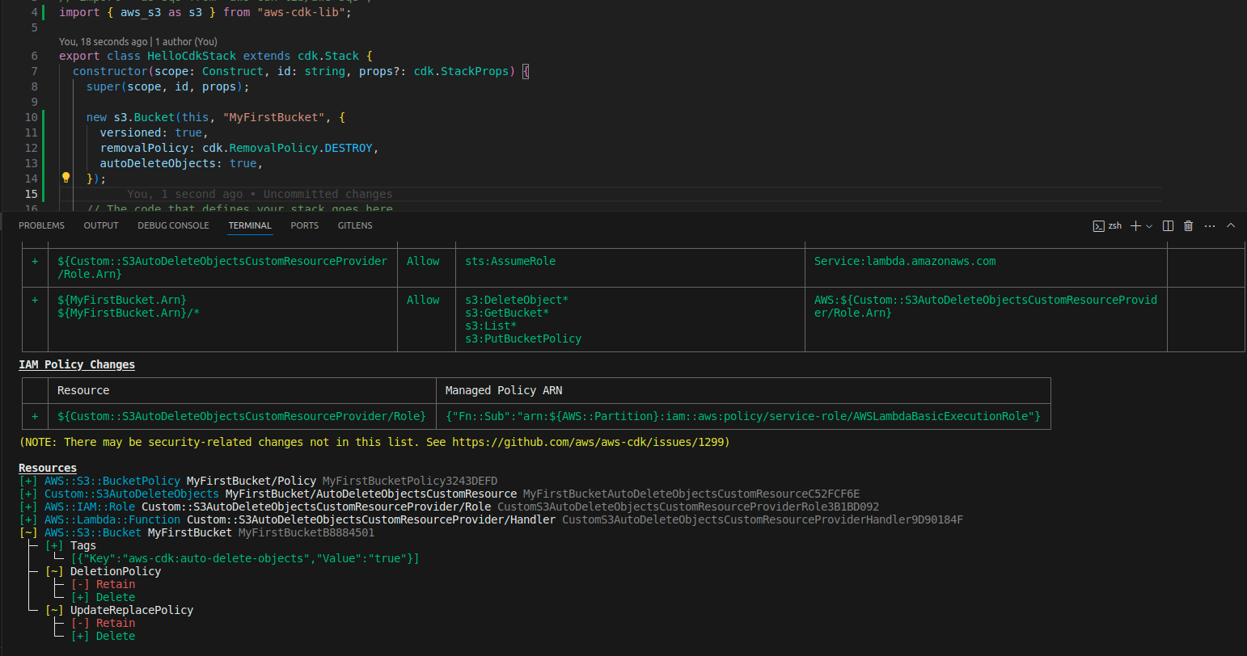
(3) Modify stack

Slide 13
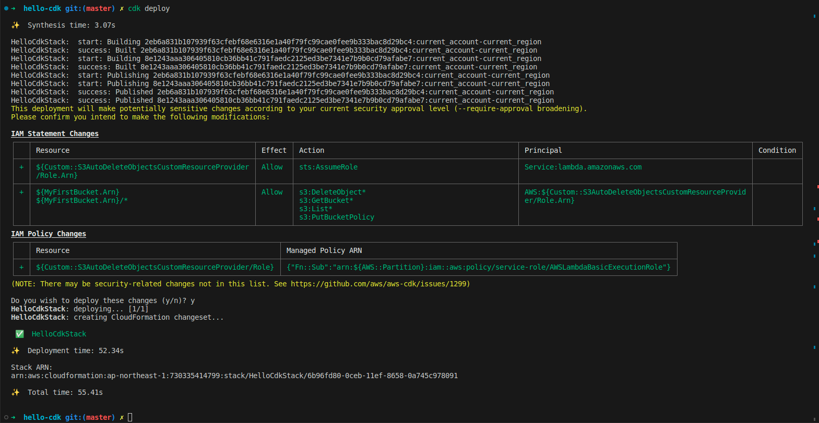
(4)Deloy

Slide 14
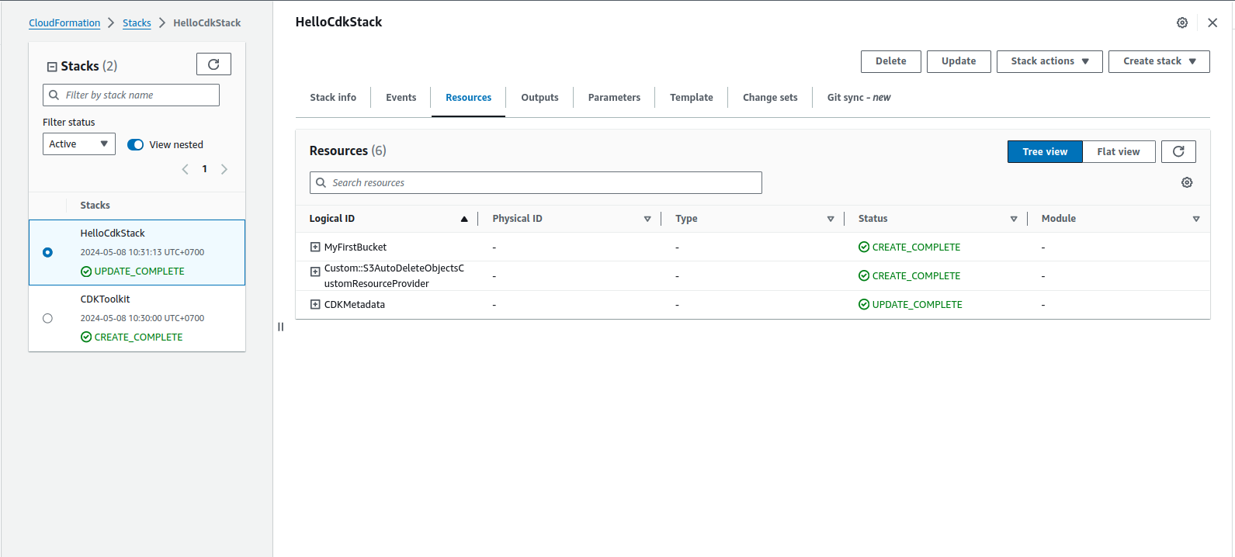
(5) Check result

Slide 16
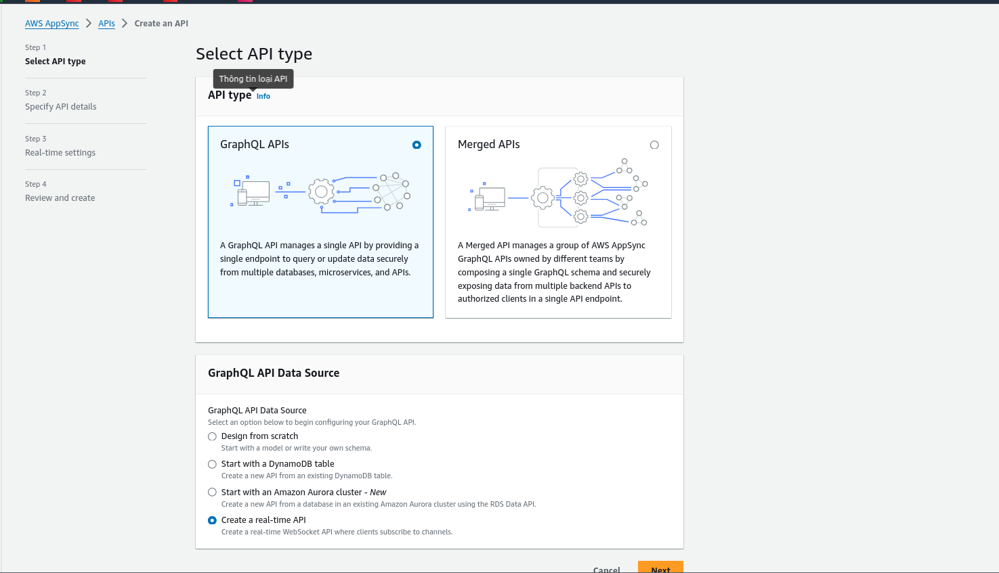
(1) Create appsync

Slide 17
review

Slide 18
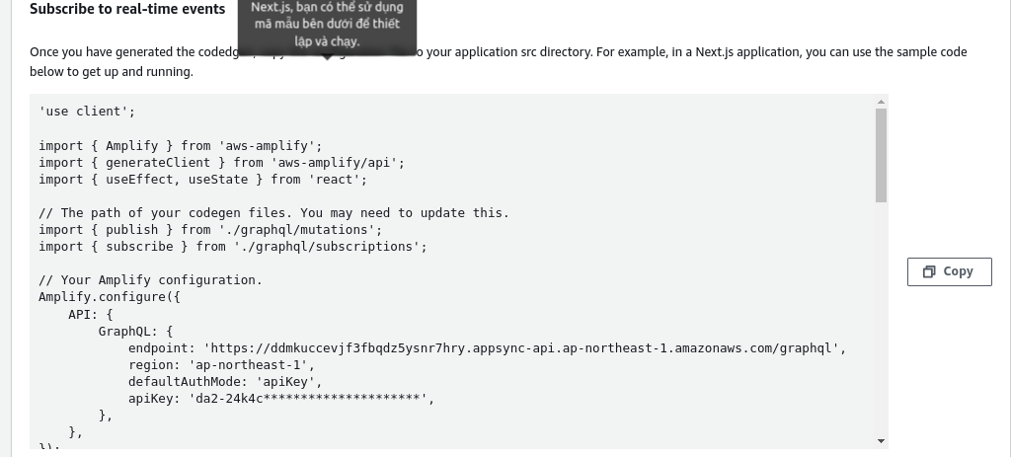
Setup client

Slide 19
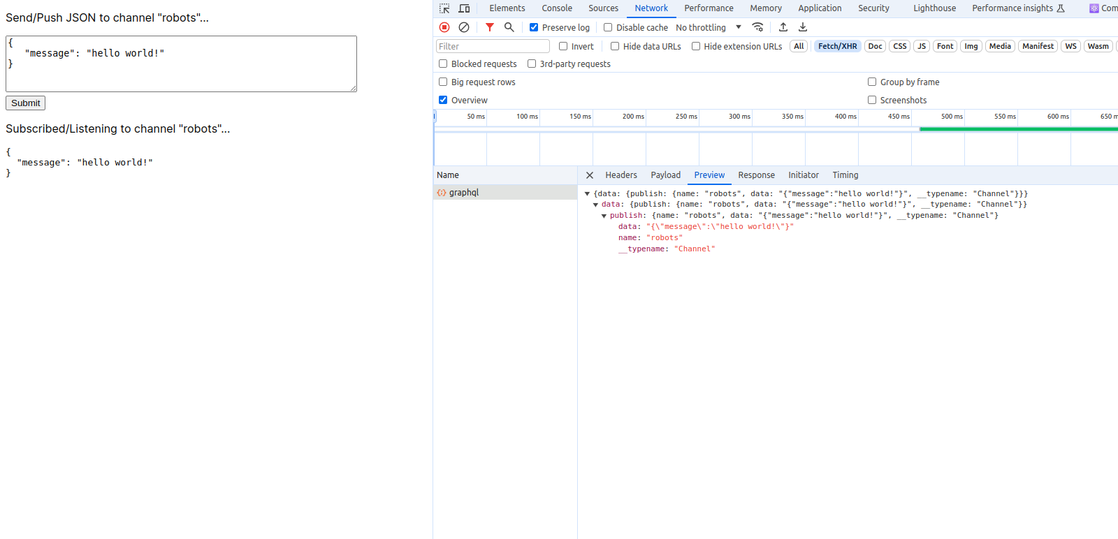
Check result

Slide 20
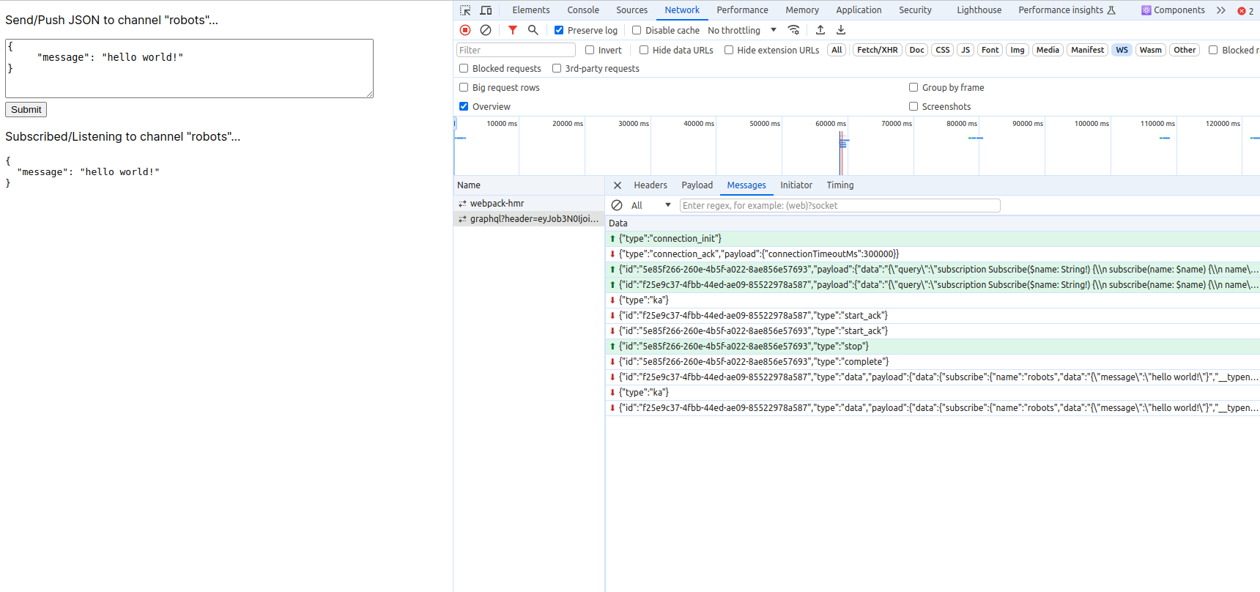
Check result

Slide 21
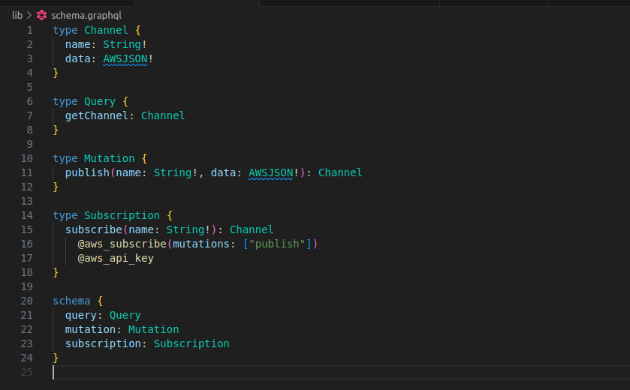
CDK: Create appsync pub/sub, noneDatasource

Slide 22
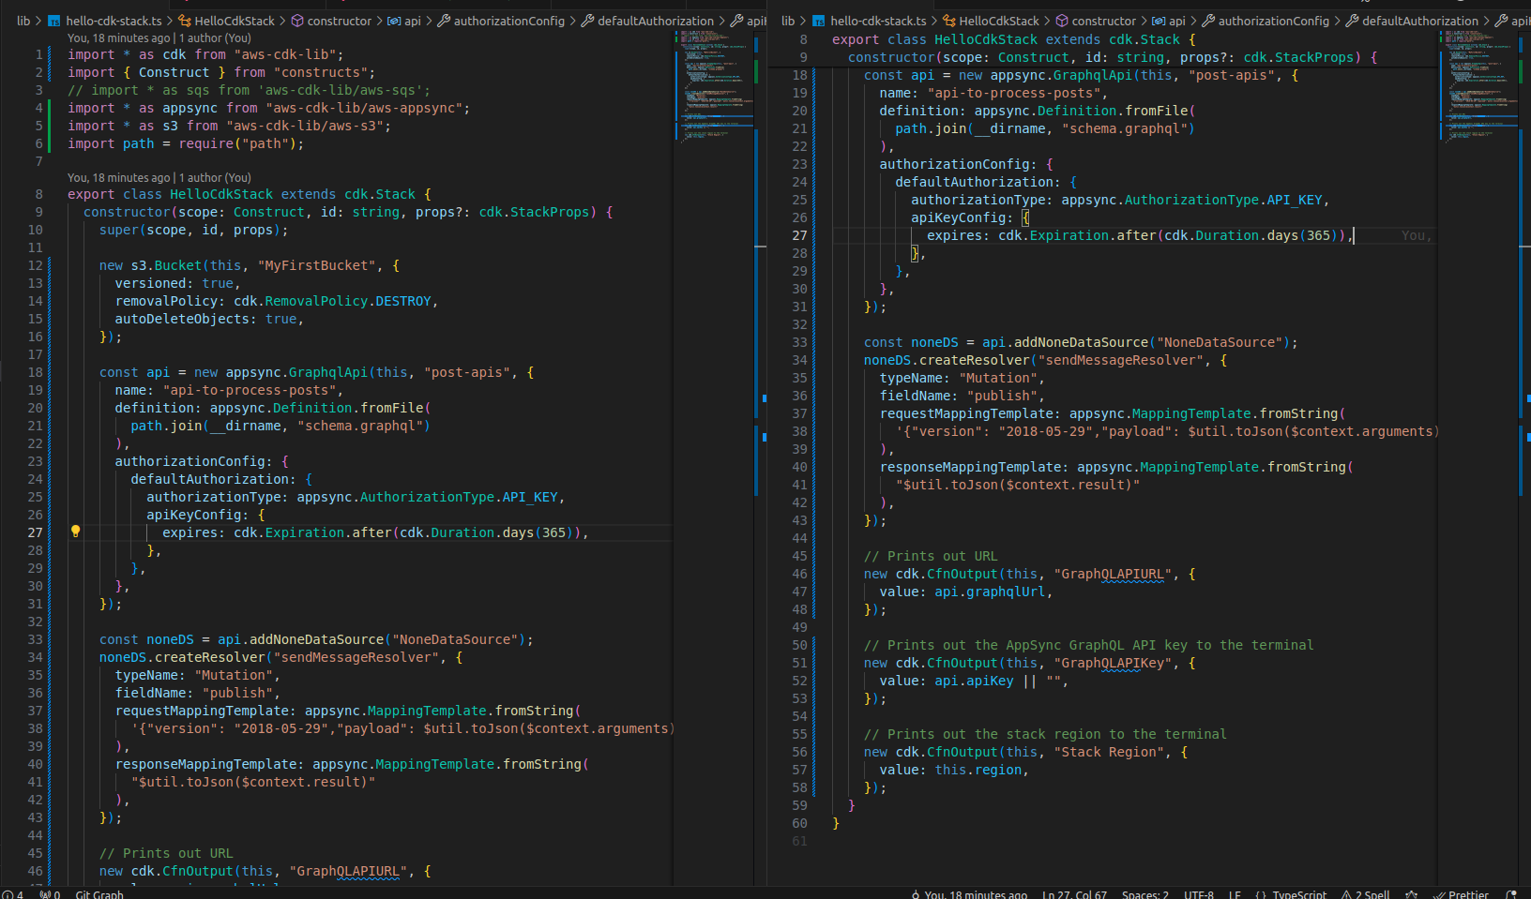
CDK: code

Slide 23
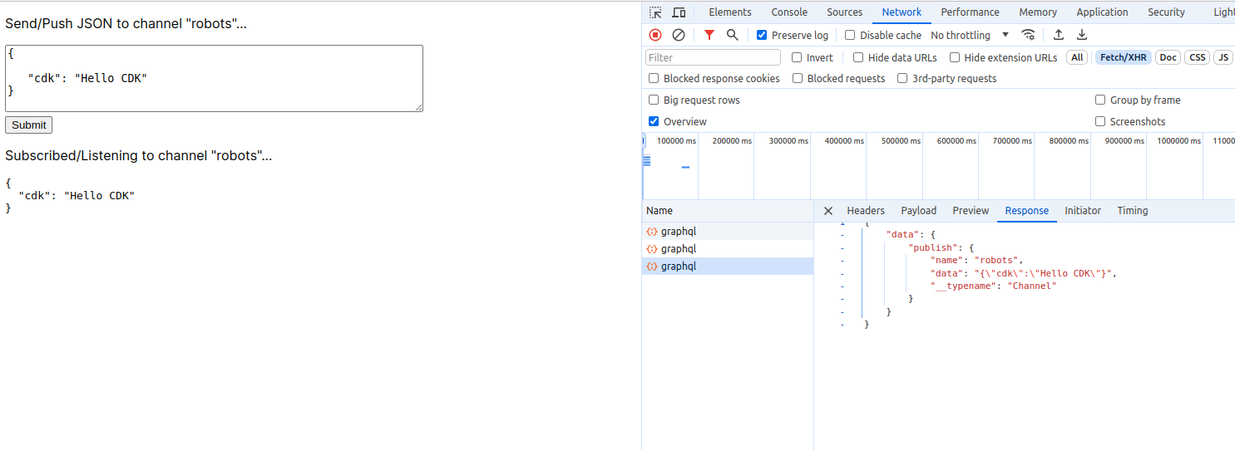
Check result

Slide 24
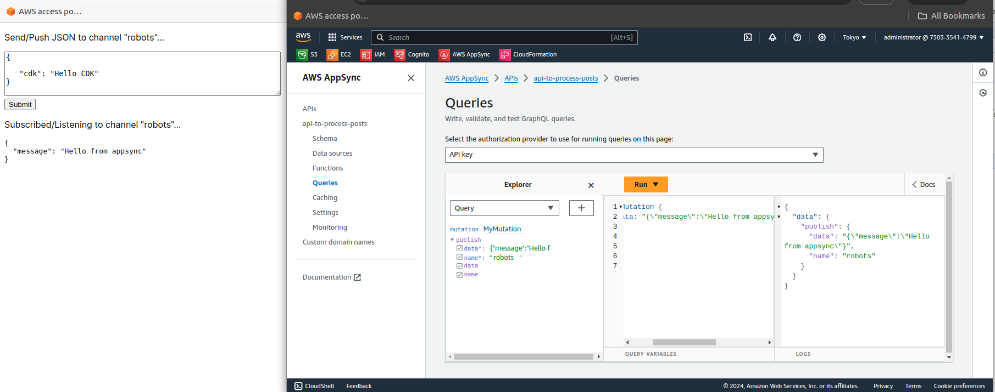
Check result

Slide 25
Appsync & Amplify

Slide 26
Learn

Slide 27
GraphQL 101: What
Query language: a special language designed for interacting with APIs. It allows you to precisely define and fetch the data you need
Client-driven: client can request exactly the data it needs
Efficiency: leininates the common problem of REST APIs where you received too little data or too much data
Schema-based:
Flexibility: can work with a variety of datasource like databases, micsoservices, or third-party API

Slide 28
GraphQL 101: Why
Optimized data fetching: say goodbye to over-fetching and under-fetching of data
Clear API structure: FE and BE dev share understanding of the API’s possibilities
Rapid development: because FE team can work more independently without waiting on extensive BE change
API revolution: Add new fields is often easier tahng REST because existing queries won’t break.

Slide 29
GraphQL 101: Glossary
Schema
Query
Mutation
Resolver
Object type
Field
Argument
Scalar type
Fragment: a reusable piece of GraphQL query logic, used to organize complex queries more efficiently
Subscription
Directive
Introspection

Slide 30
REST API 101: What
Architectural Style: REST is not a technology itself, but a set of principles that guide the design of web APIs. It provides a standardized way for systems to communicate, making them more predictable and easier to work with.

Slide 31
REST API 101: Why
Scalability: REST is well-suited for large, distributed systems due to its stateless design.
Flexibility: Can work with different data formats (JSON is very common).
Widely adopted: Developers are familiar with the concepts and there's great tooling support.

Slide 32
REST API 101: Glossary
Resources: Everything in a REST API is a resource
HTTP Methods (Verbs): REST uses standard HTTP methods to indicate what action you want to take on a resource
HTTP Status Codes: REST APIs use HTTP status codes to communicate the result of an API request
Statelessness: In REST, each request is independent.

Slide 33
gRPC 101: What
Framework, not just a style: gRPC is a modern, high-performance framework for building distributed systems. It's a more structured approach compared to REST.
RPC (Remote Procedure Call): The underlying mechanism. gRPC lets you define functions (methods) on a server that can be called directly by a client, as if the function existed locally.
Protocol Buffers (Protobuf): gRPC uses Protobuf as its data serialization format.

Slide 34
gRPC 101: What
HTTP/2: gRPC uses HTTP/2 as its underlying transport protocol. This enables:
Bidirectional streaming: Client and server can stream data to each other simultaneously.
Multiplexing: Multiple requests can be made over a single connection.

Slide 35
gRPC 101: Why
Speed: The combination of Protobuf and HTTP/2 generally makes gRPC significantly faster than REST APIs, especially for heavily used services.
Strict Contracts: Protobuf enforces a schema for communication, ensuring type safety and reducing potential API errors.
Language Support: gRPC has official support for many popular languages (Java, Python, C++, Go, Node.js, etc.)
Real-time features: gRPC's streaming capabilities make it well-suited for real-time or low-latency use cases.

Slide 36
REST API 101: Glossary
Resources: Everything in a REST API is a resource
HTTP Methods (Verbs): REST uses standard HTTP methods to indicate what action you want to take on a resource
HTTP Status Codes: REST APIs use HTTP status codes to communicate the result of an API request
Statelessness: In REST, each request is independent.

Slide 37
Feature | GraphQL | REST | gRPC
Paradigm | Query language for APIs | Architectural style for APIs | High-performance RPC framework
Data Fetching | Client-driven, single request | Resource-oriented, multiple requests may be needed | Efficient, single request
Data Format | Primarily JSON | JSON, XML, etc. | Protocol Buffers (binary)
Transport | HTTP | HTTP | HTTP/2
Contract | Schema-driven | Less strict (API documentation needed) | Strongly typed (Protobuf)
Streaming | Supported | Limited (SSE, WebSockets) | Built-in, bidirectional
Performance | Good, potential for over/under-fetching | Good, but depends on implementation | Generally fastest, especially internal calls
Developer Experience | Moderate learning curve | Simpler to get started | Steeper learning curve (Protobuf)

Slide 38
Scenario | GraphQL | REST | gRPC
Client-driven UI, Multiple Data Sources | Ideal | Workable, but potential over-fetching | Less ideal
Public API, Simplicity | Good | Great | Less ideal, unless performance is top priority
Internal Microservices, Performance is Key | Good | Workable | Ideal
Real-time Data (Chat, Updates) | Possible (subscriptions) | Limited (polling, WebSockets) | Ideal

Slide 39
Appsync 101: What
Managed GraphQL Service: AWS AppSync takes the complexities of setting up and managing your own GraphQL server off your hands. It's a fully managed service, meaning you focus on your app logic, not infrastructure scaling.
Flexible Data Sources: DynamoDB, Lambda, OpenSearch, HTTP, EventBridge, Relational databases, None data source
Real-time Updates: built-in support for subscriptions (using WebSockets), enabling you to send real-time updates to connected clients
Offline Capabilities: AppSync can automatically handle data conflicts when clients go offline and reconnect

Slide 40
Amplify 101: What
AWS Amplify is a collection of tools and services designed to help developers build and deploy web and mobile applications quickly and easily on AWS. It aims to streamline the full development lifecycle.

Slide 41
Amplify 101: Why
Simplified Development: Build modern full-stack applications without needing deep expertise across all AWS services.
Faster Time to Market: Focus on writing app logic, not infrastructure provisioning and management.
Scalability: Amplify uses AWS services that automatically scale based on demand.
Iterative Development: Supports a streamlined build, test, and deployment process.

Slide 42
Amplify 101: Components
Amplify Libraries & UI Components
Amplify CLI
Amplify Studio
Amplify Hosting

Slide 43
Amplify 101: Key feature
Authentication: Easily add user sign-up, sign-in, and multi-factor authentication (MFA) using Amazon Cognito.
Data Storage: Set up databases (relational or NoSQL), file storage (S3), and implement GraphQL or REST APIs powered by AWS AppSync.
Serverless Functions: Create Lambda functions to execute custom logic or extend your backend.
Analytics: Integrate analytics to track user behavior.AI/ML: Add pre-trained AI/ML services (predictions, text translation, image/text analysis) from AWS.
Push Notifications, Pub/Sub, and more: Enhance your apps with other features as needed.
Notes:
It’s dangerous to automate what you don’t understand Plugin
GraphQL for VSCode: adds syntax highlighting and auto-complete support for GraphQL schema files.
Serverless IDE: adds intellisense and auto-complete support for AWS SAM, Serverless framework. You should install cfn-lint as well to add syntax support for CloudFormation.
Tailwind CSS IntelliSense: adds intellisense and auto-complete support for Tailwind CSS.
Velocity: adds syntax highlighting for Velocity templates.
Vetur: vue tooling for VS Code.

Slide 44
Hand-on

Slide 45
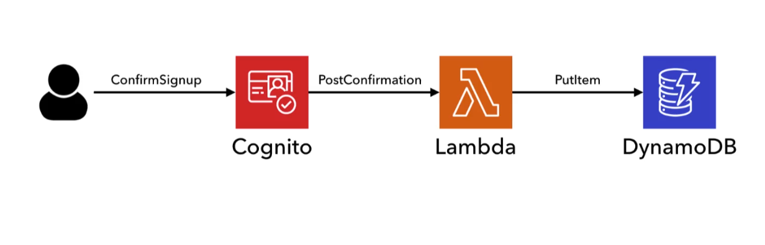

Slide 46
Code: Lambda
Github: https://github.com/uzuhinta/serverless_utwitter

Slide 47
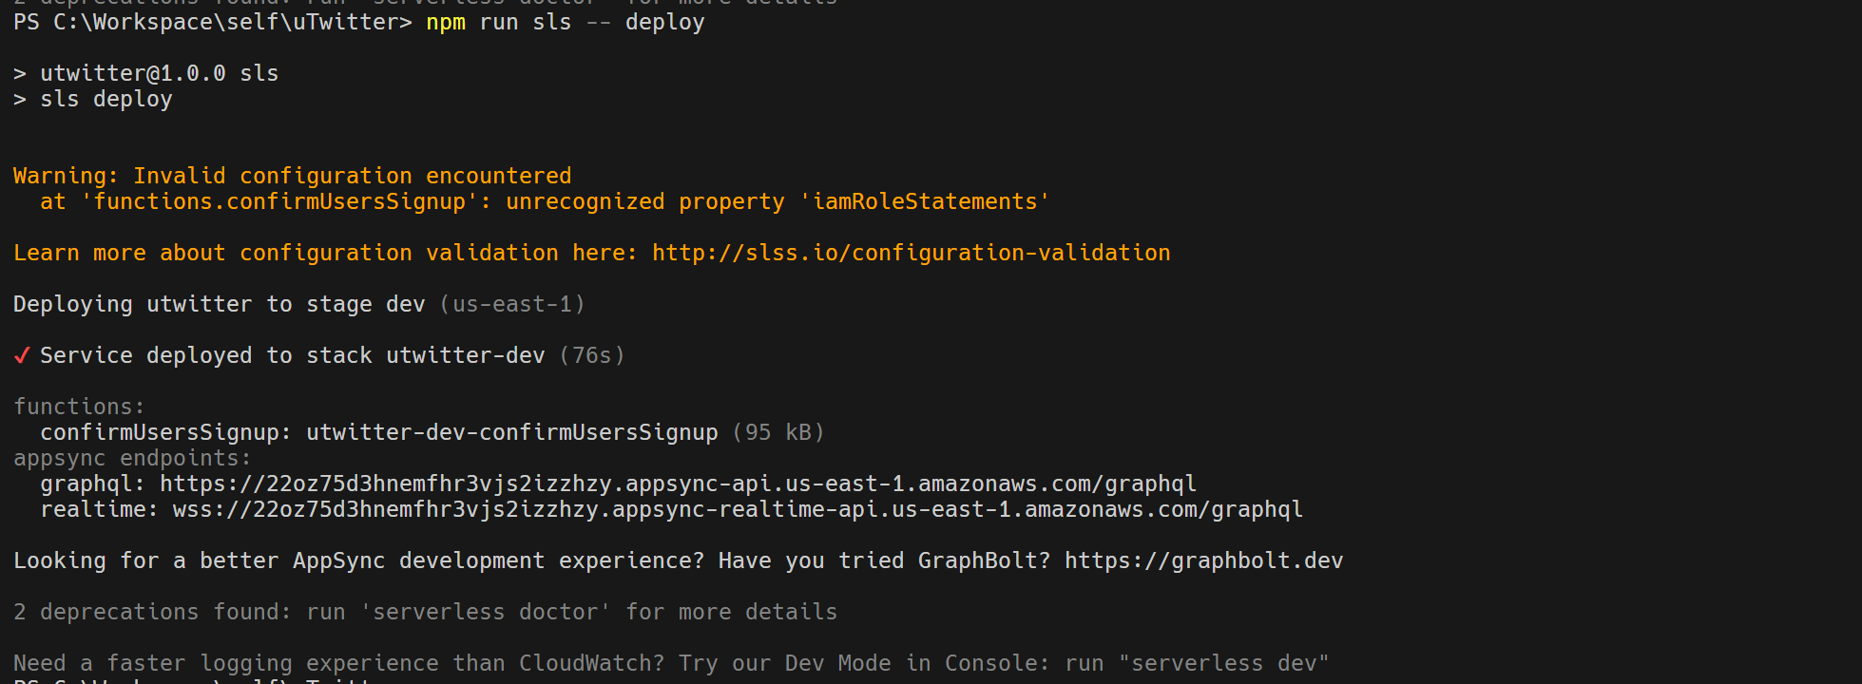
Deploy

Slide 48
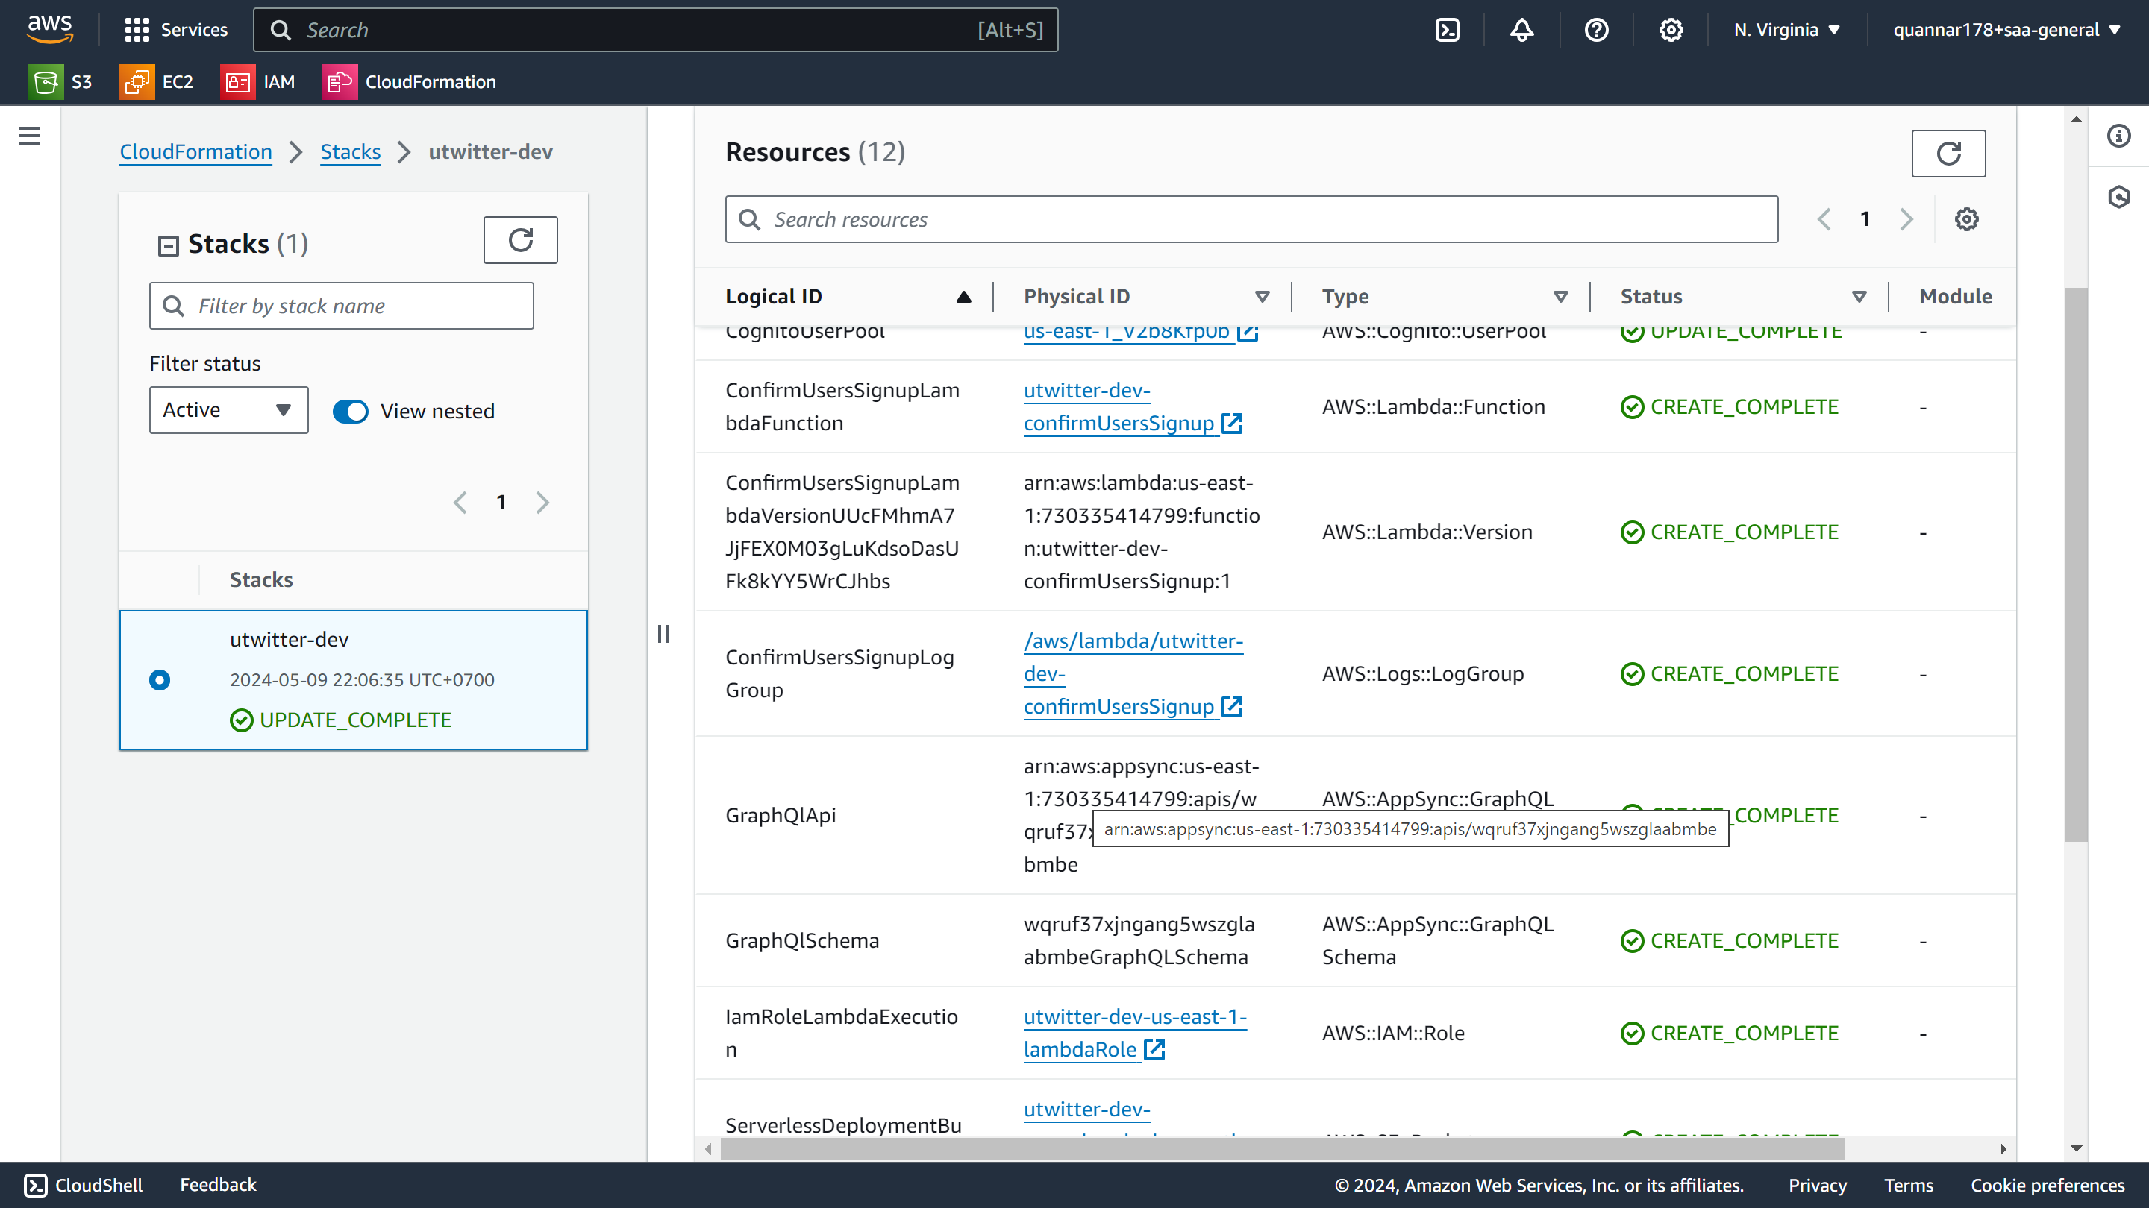
Check result

Slide 49
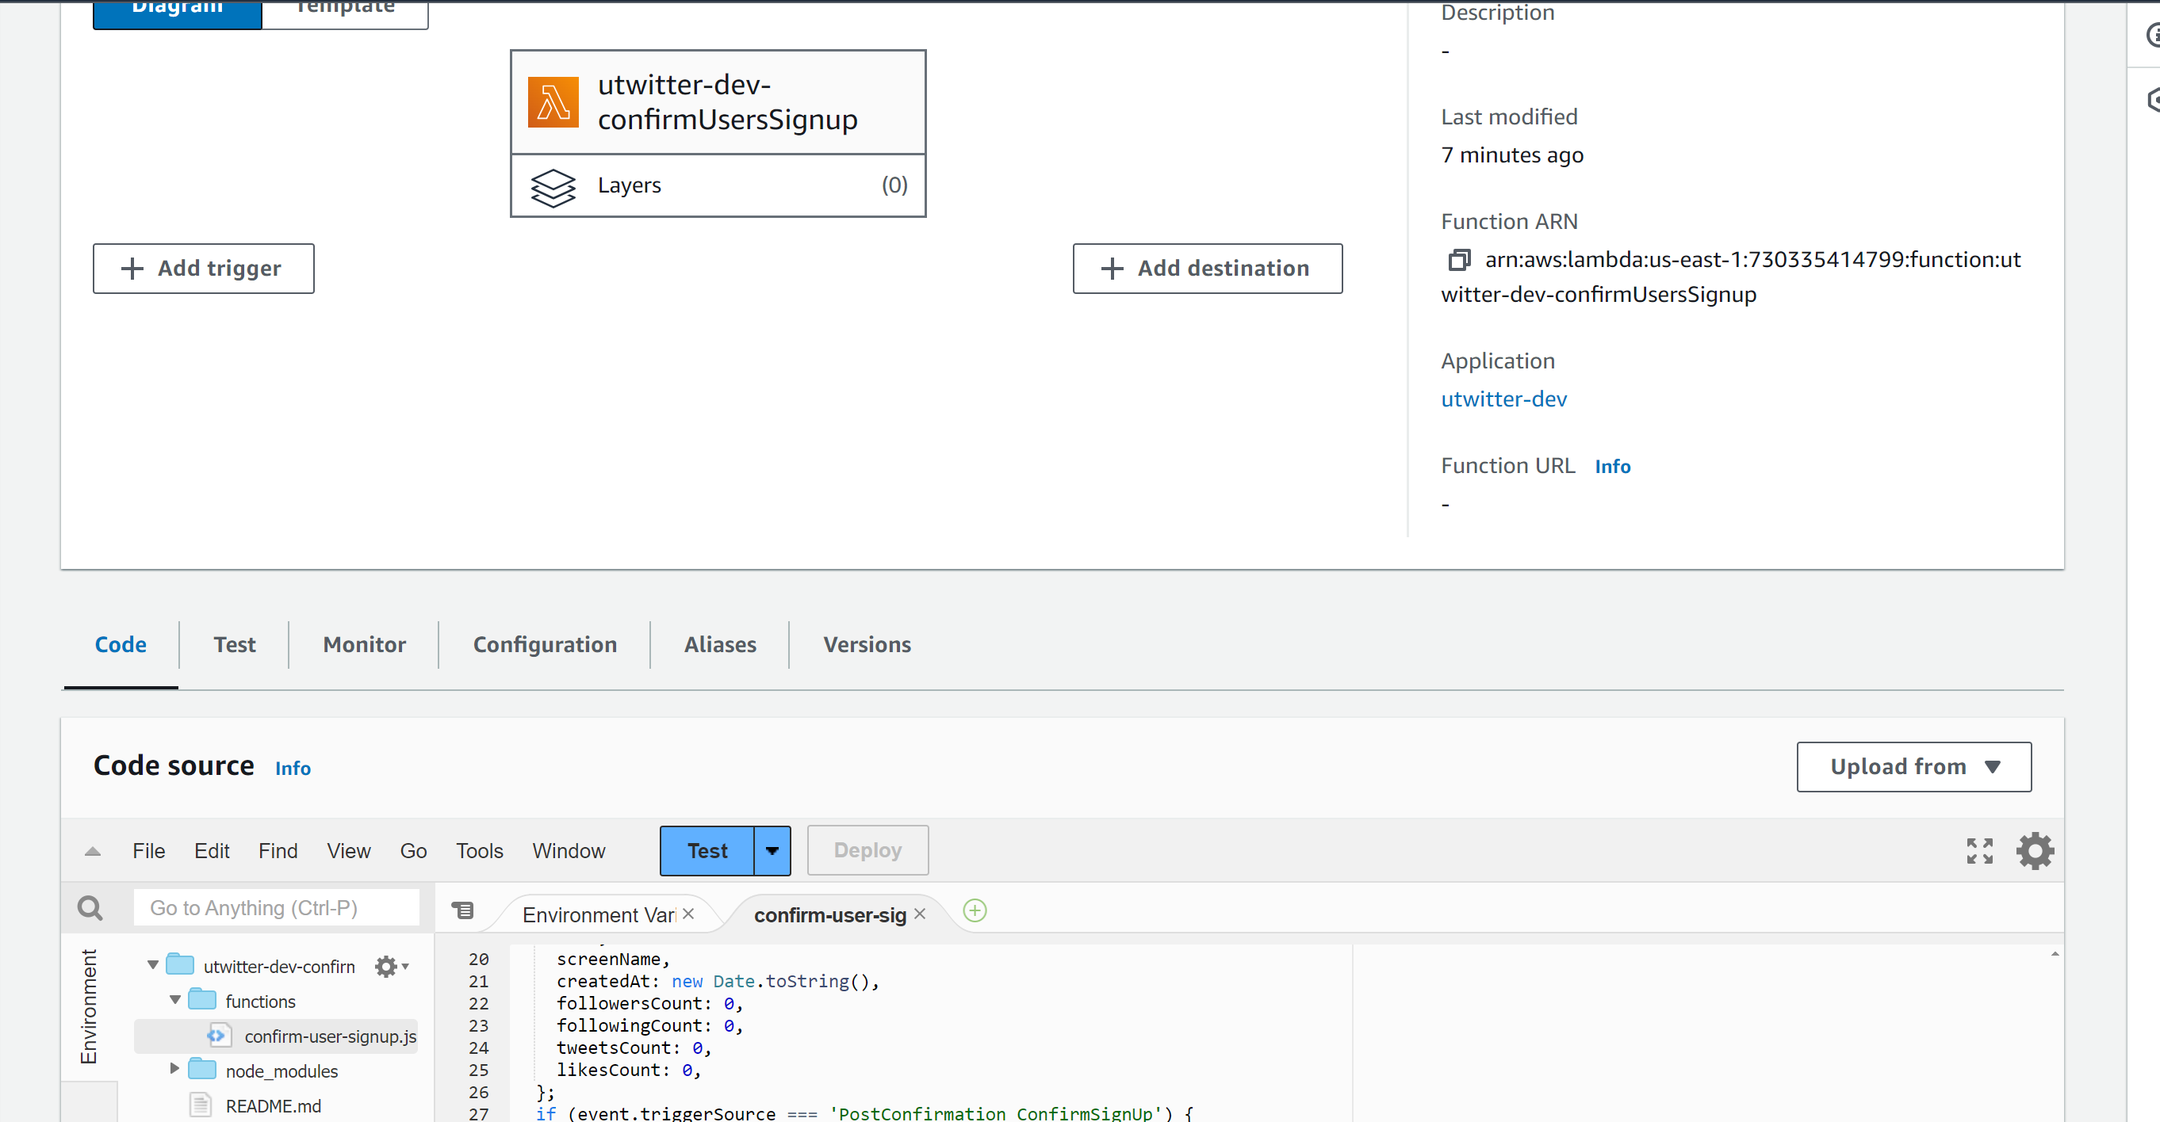
Check result: lambda

Slide 50
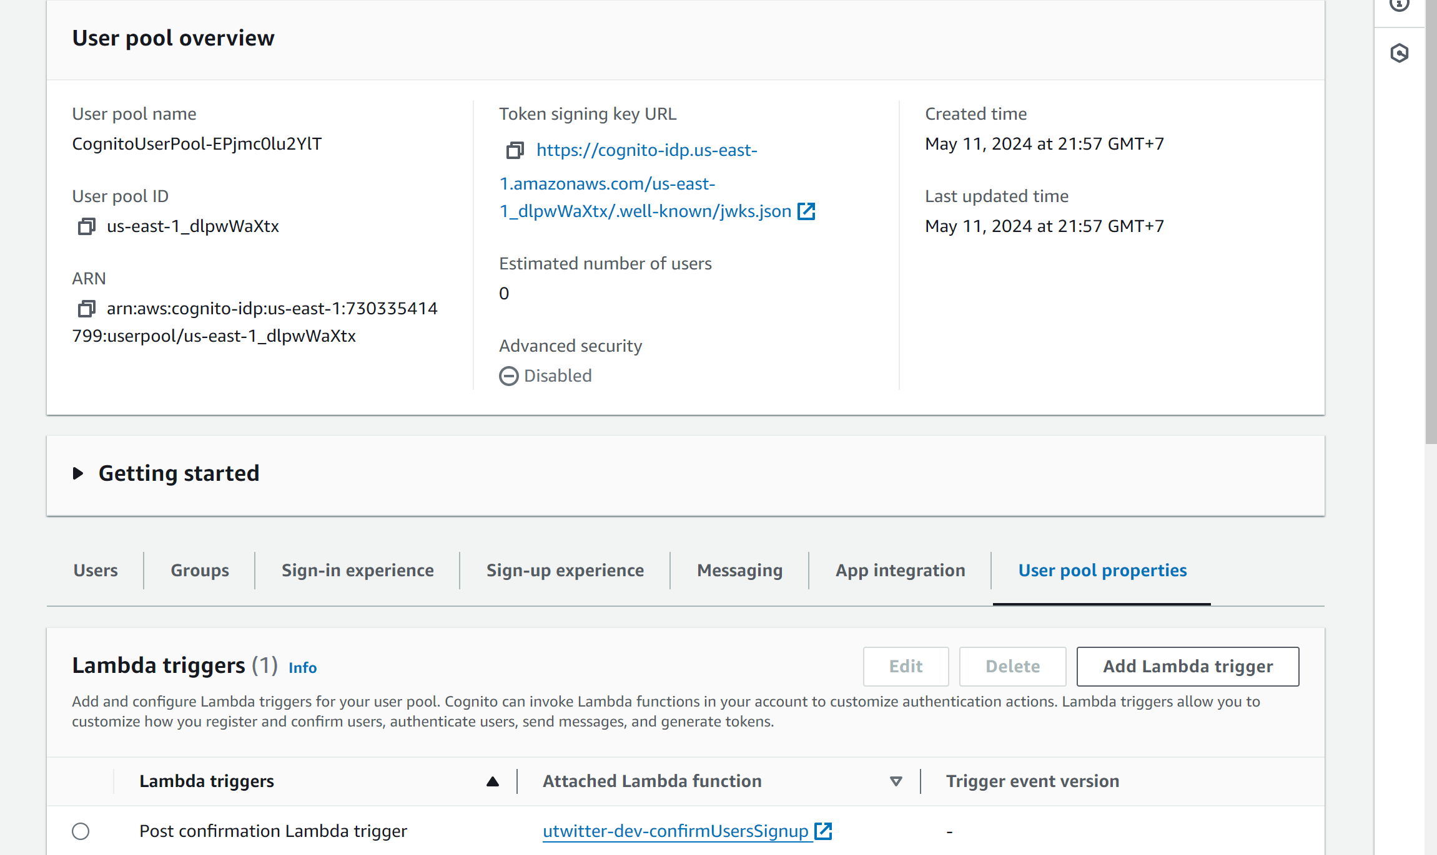
Check result: cognito

Slide 51
Next step
Hoàn thiện đầy đủ chức năng uTwitter

